Slide 1
Climate Change in the Kawarthas Updated December 2017– Part 2
Peterborough Flood of July 2004

Slide 2
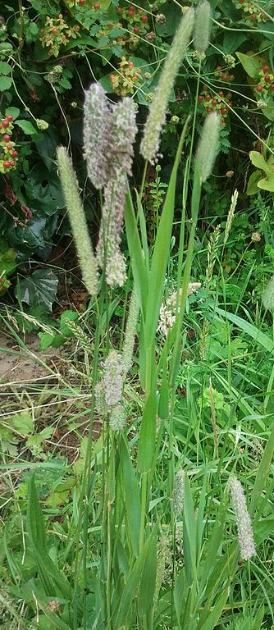
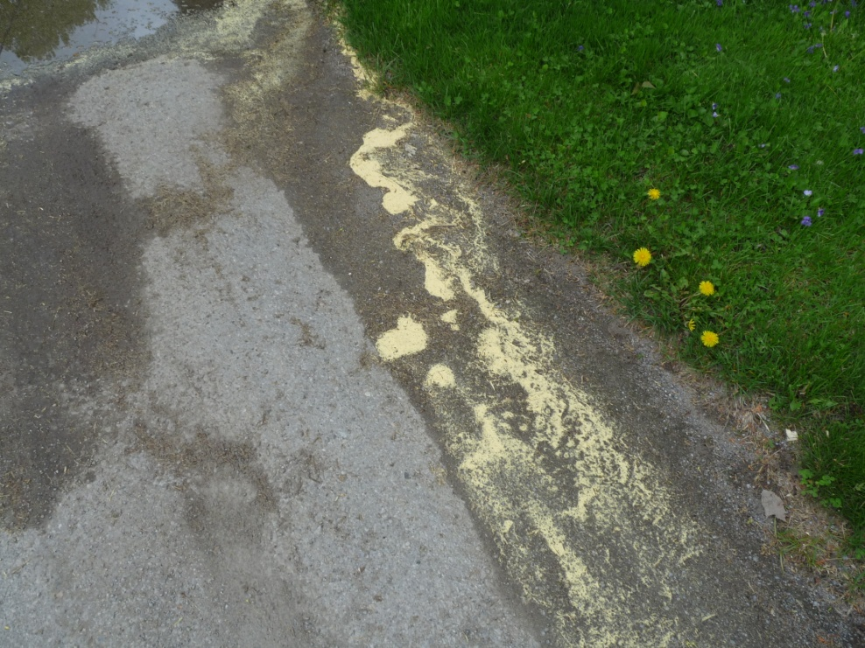
Earlier and more abundant grass & tree pollen
Tree pollen is emerging roughly two weeks earlier in the spring in much of N.A.
Pollen counts are expected to more than double by 2040
We can expect a large increase in pollen production in grasses (e.g., Timothy) due to increased CO₂. Up to 200% more - PLOS 1, Nov. 2014
Many people already experiencing more serious allergy symptoms

Slide 3
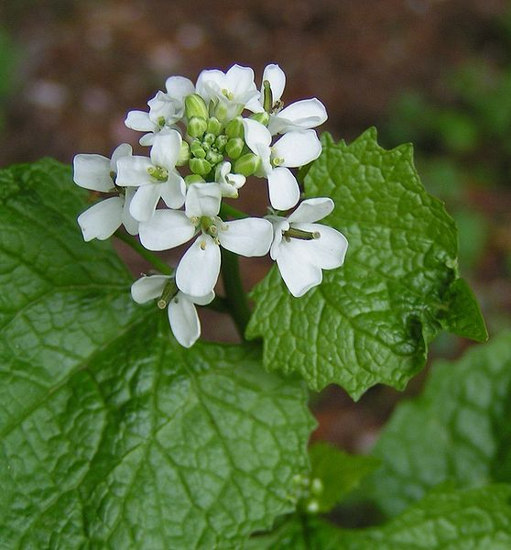
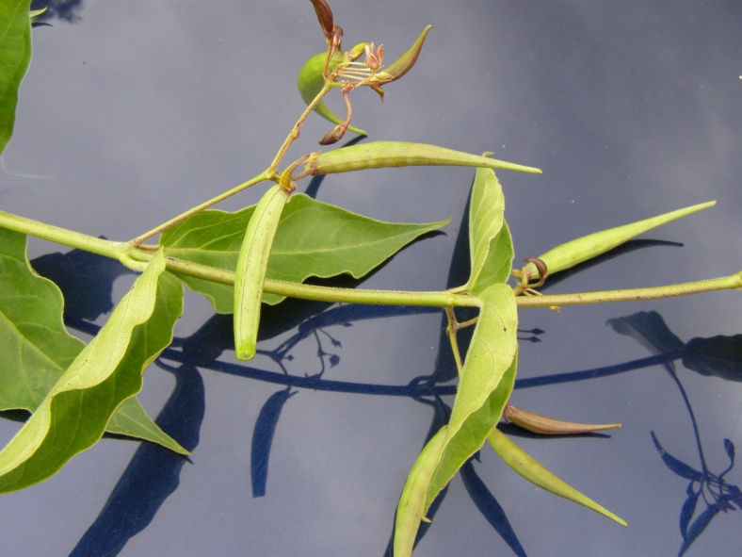
A marked increase in invasive species – more adaptable to a warming world than native plants - thrive in higher atmospheric CO2 levels
Common Reed (Phragmites)
Purple Loosestrife
Dog-strangling Vine
Garlic Mustard

Slide 4
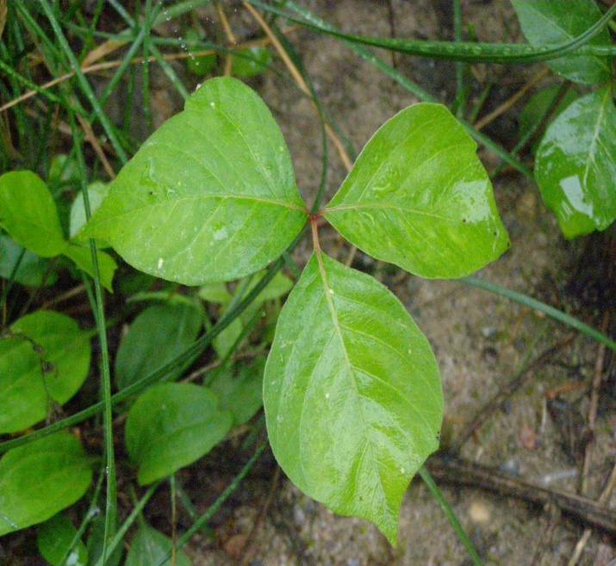
Thriving Ragweed and Poison Ivy Higher CO2 levels in atmosphere may explain increase in size and abundance Ragweed shedding pollen up to a month longer than it did in 1995 Poison Ivy growing faster and is more toxic
Ragweed
Poison Ivy

Slide 5
A huge decline in Monarchs
AREA OCCUPIED BY MONARCH COLONIES AT OVERWINTERING SITES IN MEXICO
1996-1997: 18.19 hectares
2012-2013: 1.19 hectares
2013-2014: 0.67 hectares
2014-2015: 1.13 hectares
2015-2016: 4.01 hectares
2016-2017: 2.90 hectares
Elimination of milkweed is main cause (Round-up ready GMO corn and soybean in mid-western U.S.)
Climate change is also a cause
during migration (drought, heat)
on the breeding grounds (arriving before milkweed is up)
Mexican wintering grounds (winter storms more frequent – 75% mortality in 2002; Oyamel firs in jeopardy)
Current population extremely vulnerable to winter storms
Tagging at Presqu’ile P.P.
Photo from Mexican wintering grounds

Slide 6
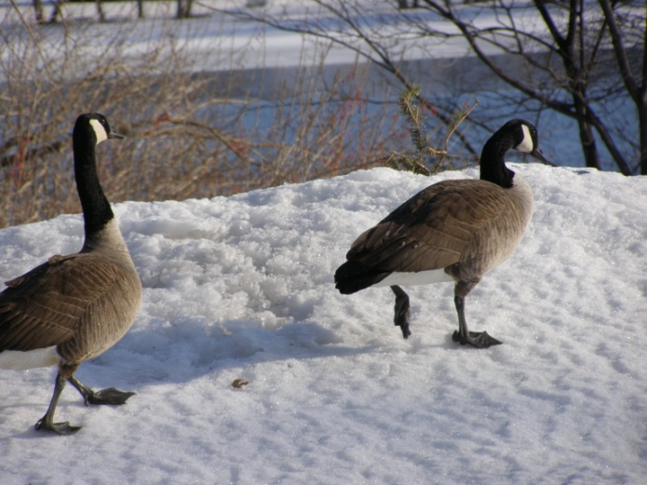
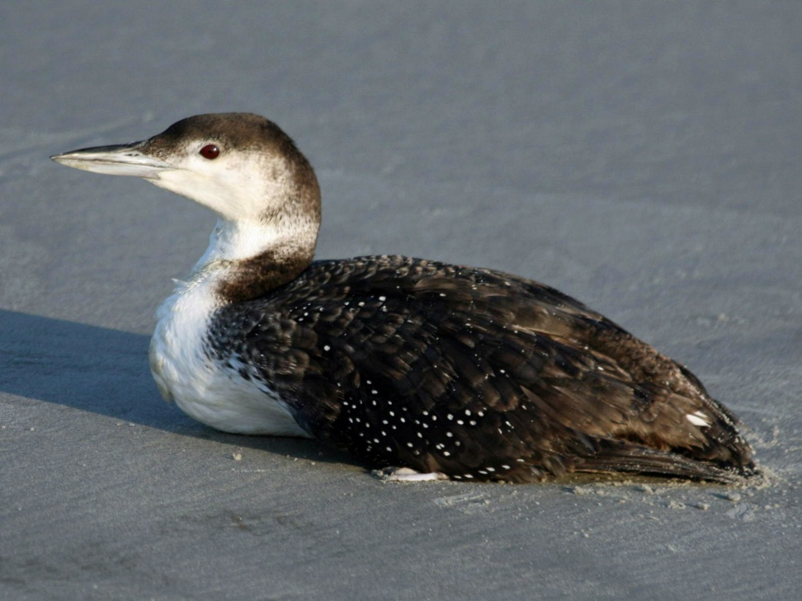
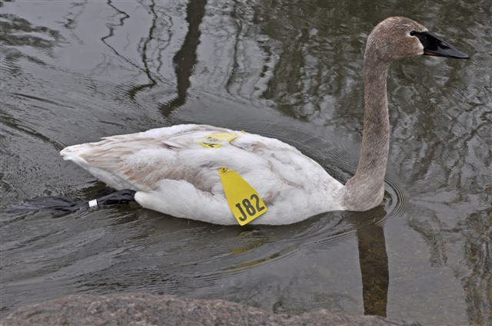
Later freeze-up means later fall departure of waterbirds
Common Merganser
Canada Geese
Common Loon
Trumpeter Swan

Slide 7
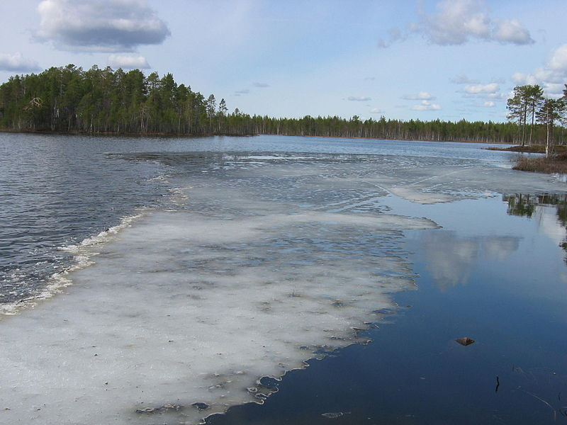
Extreme Events March 2012
8 days of 20 C temperatures mid-March (Mar. 22 – 26C)
Frogs calling four weeks early
Mourning Doves beginning to nest
Trees came into flower
Many flowers were killed by April frosts, resulting in an 80% loss in Ontario’s apple production.
Ice-out on March 20, a full month earlier than the long-term average
Weather Weirding poem, 2012
Notes:
Weather Weirding, 2012
Barbara Crooker,
Pennsylvania
An odd spring, crocuses blooming
alongside tulips. Bluebirds, confused,
go back to sky. In March alone, fifteen
thousand heat records broken. Each breeze
wafts apocalypse. Colorado blazes
up in flames. July’s transposed
with August; peaches and corn
a full month early. A string of days
over 100°, a rope of malignant pearls.
Katydids kick up their cadence,
did not,
did too
in the heat of the furnace.
This used to mean six weeks to frost;
not now. The Des Moines River
reaches 97°, thousands of fish
turn belly up. The Mississippi shrinks,
loses shipping lanes. Sea water’s
too warm for nuclear power. Two months
early, chrysanthemums explode in August—
blood red, chrome yellow, rust orange.
And then, in October, barreling up
from the tropics, mating with a nor’easter:
Sandy. And what comes next?

Slide 8
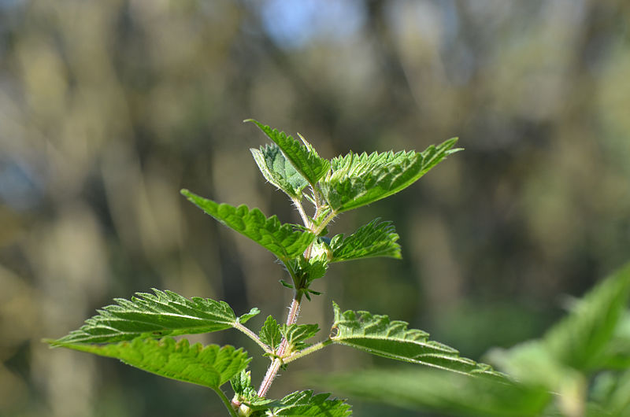
Extreme events – Red Admiral invasion of April 2012
Unprecedented numbers (300 million plus) of migratory Red Admirals
Linked to unprecedented drought in Texas (climate change?)
Drought had killed predators of Red Admiral caterpillars
With rains, abundant wildflowers and huge reproductive success
Wave after wave came north out of Texas from April through May
Arrived too early to lay eggs, since nettles were not yet up
Red Admirals feeding on tree sap
Stinging Nettle
Notes:
In 2012, due to an abnormally early and hot spring and summer, the butterflies got too far north, too early, and they dispersed through a lot of places where there wasn't any milkweed, which pushed the population numbers downward, explained Taylor.

Slide 9
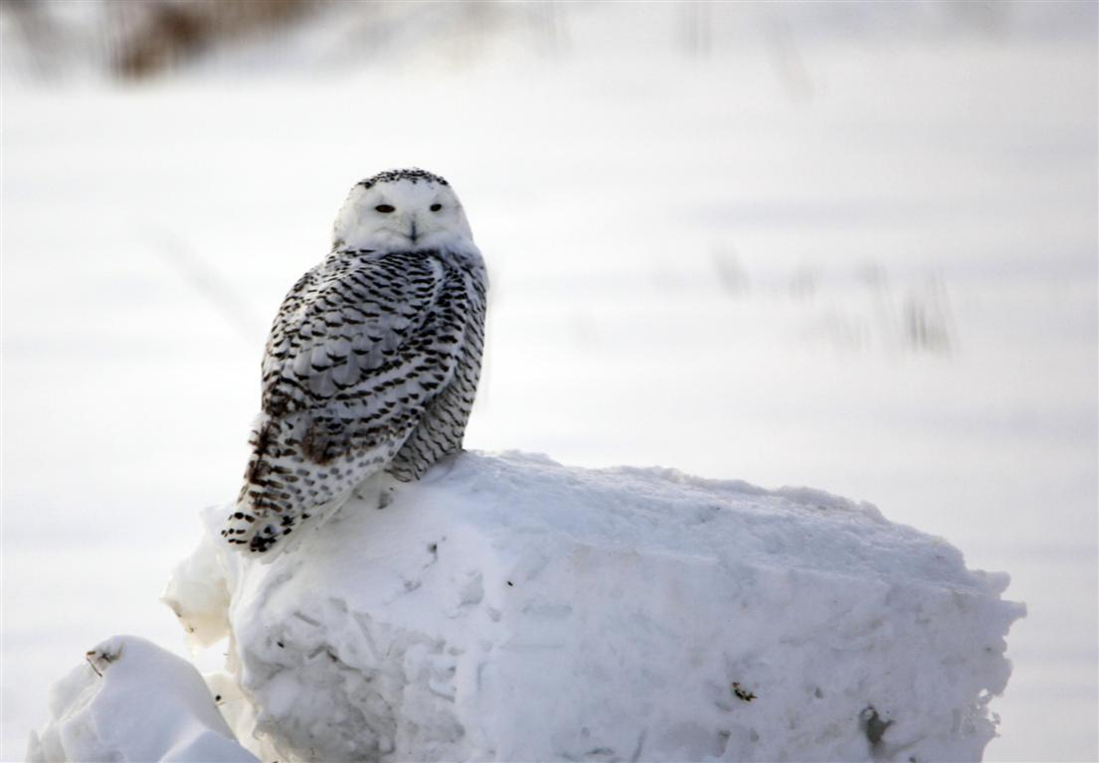
Extreme Events Winter 2014
Peterborough temperatures cooler than average since November
Feb. 4 C cooler, Mar. 6 C cooler. Great Lakes frozen over 90%
Displaced ducks turned up on
the Otonabee River
Unprecedented invasion of Snowy Owls due to population explosion on Arctic breeding ground (abundant lemmings; CC connection may explain lemming abundance )
Warming of the Arctic & retreat of Arctic ice may be causing changes in the Jet Stream. Result? Prolonged spells of extreme weather including heat waves (e.g., California) & freezing temp’s (winter 2014)
Red-breasted Merganser on Otonabee
Chemong Rd. Snowy Owl

Slide 10
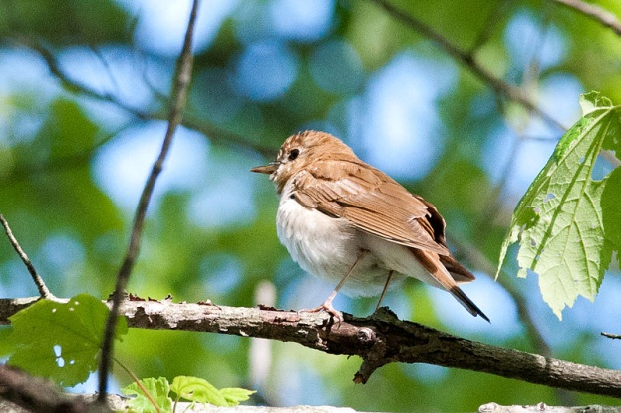
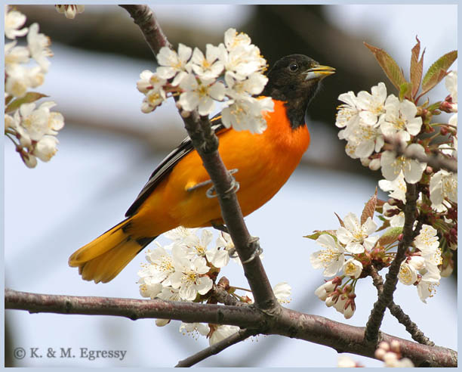
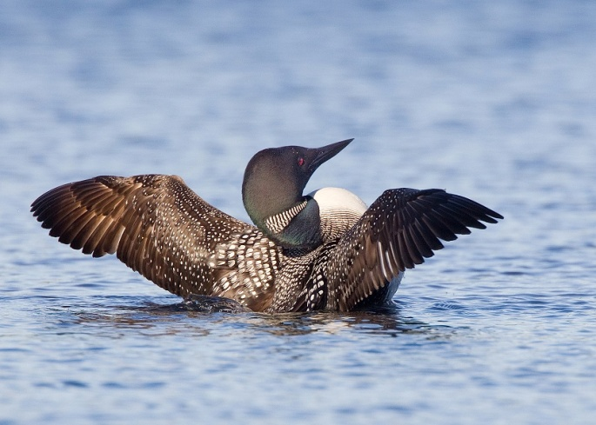
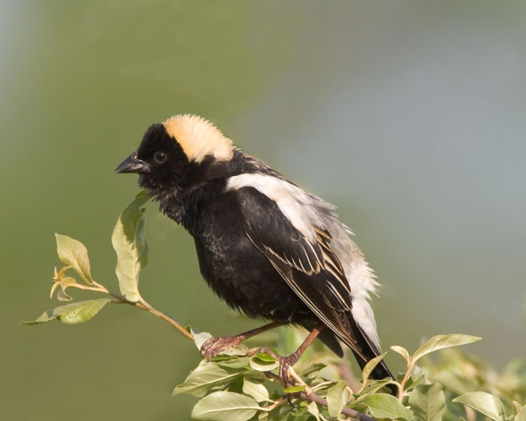
Concern for the future – Loss of bird diversity Audubon Birds and Climate Report (Sept. 2014): 314 of the 588 North American species studied will lose more than 50 percent of their current climatic range by 2080. As for the Kawarthas, a number of iconic birds will probably no longer be able to breed here, their range having moved much further north.
Veery
Hummingbird
Ovenbird
Baltimore Oriole
Bobolink
Common Loon

Slide 11
Concern for the future Changes in Autumn Leaf Season
Changes in precipitation could impact the brightness and brilliance of fall colors
Increased likelihood of extreme precipitation in central Ontario may dull the colours (more cloudy days = less photosythesis = fewer anthocyanins = less red in the leaves)
Tree species may migrate northward
Longer summers may delay on-set of colours
Source: Howard Neufeld, Professor of physiological plant ecology, Appalachian State University

Slide 12
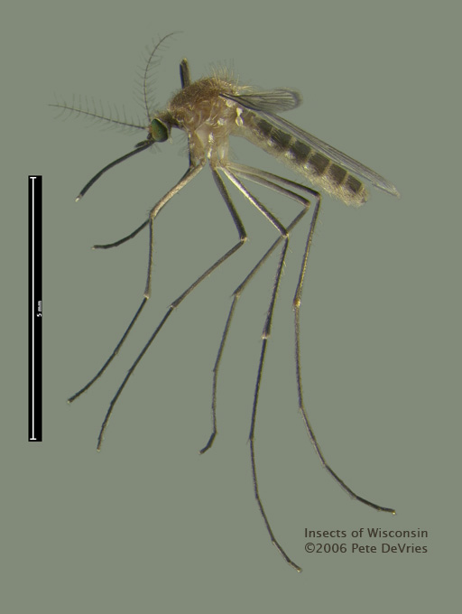
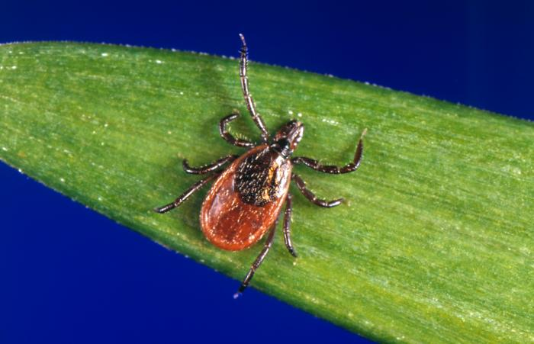
Concern for the future: Less winter insect mortality
Milder temperatures are allowing more insects to successfully overwinter.
Possibly explains the increase in West Nile disease in 2012. Worst year ever in U.S.
Lyme disease is present along Lake Erie and Lake Ontario as Black-legged Ticks are now able to overwinter in Ontario. Will have spread over all of Southern Ontario by 2020.
Insects in general – including pests - should thrive in a warming climate and have more lifecycles.
House Mosquito (Culex pipiens)
Black-legged Tick

Slide 13
Concern for the future a decline in forest health
Increased temperature, more frequent drought, competition with invasive plant species (e.g., European Buckthorn), greater risks from insect pests (e.g., Emerald Ash Borer, Gypsy Moth) and fungal infections (Butternut canker, American Beech bark disease)
By mid-century, we won’t have the temperature and precipitation regime for the kind of forest and vegetation we have now. “Our climate” will have moved into northern Ontario.
A number of tree species may disappear from our forests.

Slide 14
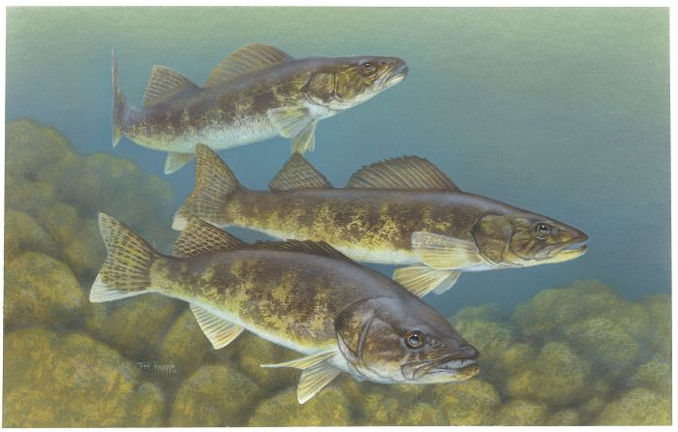
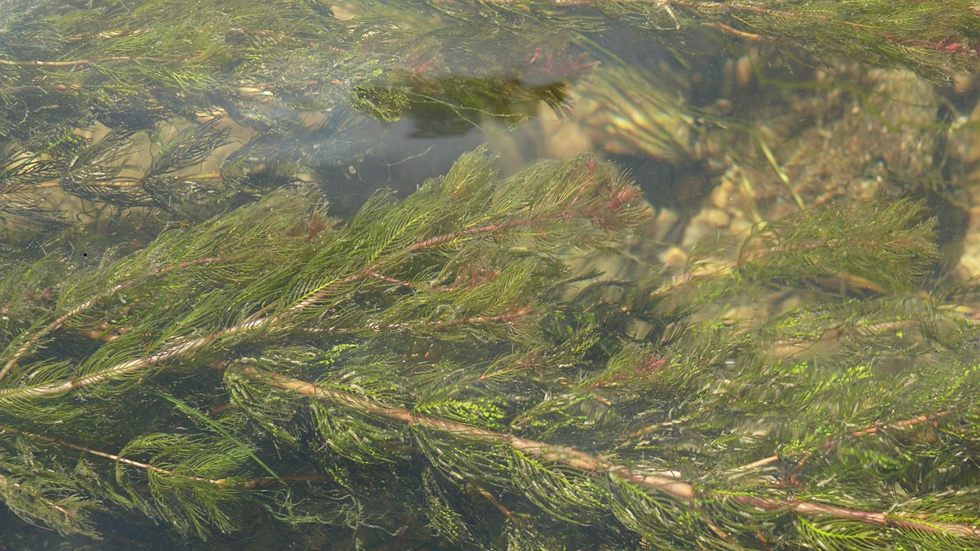
Concern for the future - decline in lake & river health
Earlier ice-out and later freeze-up
Warmer temps & increased evaporation may lead to lower water levels
Altered stream flow patterns
Decreased water quality
Warmer water fish (large-mouthed bass) should do well
Cool water fish (walleye) may decrease
Conditions may allow non-native fish (e.g., round goby) to thrive & out-compete native species for food
An increase in the types and abundance of invasive species (e.g., zebra mussel, rusty crayfish, spiny waterflea, Eurasian water-milfoil, Frog-bit, Fanwort)
2012 was one of the worst summers on record for aquatic plant-related problems for boaters (Source: marina owner, Buckhorn Lake)
Walleye
Zebra Mussels
Eurasian Milfoil

Slide 15
Concern for the future emotional distress
A change in how it “feels” to live in the Kawarthas - new species, new climate, extreme weather events
The disappearance of some seasonal rituals we’ve had for so long (e.g., a backyard rink, cross-country skiing)
A sense of loss when valued natural environments are disrupted or degraded (e.g., loss of trees in wind storms, loss of species like nighthawks)
Notes:
The Innocence of Ice
Jamie Sweitzer Brandstadter,
Pennsylvania
Spirals of smoke rose up to meet the clouds each time we exhaled, and the sunlight glistened in the beads of sweat that our bodies had expelled despite the cold temperature. There was laughter; there was always the over-arching dome of innocence, isolation, and fulfillment that came from a winter’s day on our grandmother’s pond.
The ritual had survived for generations. We were kids playing hockey; we had makeshift goals, hammered-together pieces of plywood or soup boxes that were found in the third floor of the barn; we had hand-me-down skates that had been laced and re-laced since the early 1950s; we had hand-me-down sticks that were held to-gether by electrical tape and twine; we had Carhartt jackets and retro earmuffs. But we were champions.
Many of the best games were played by the glow of the dusk-to-dawn light whose consistent, unconditional love was powered by coal birthed in that same Pennsylvania valley, or the valley over. On other nights, all we needed was the light of the moon and stars. On the ice, time itself seemed suspended, as seven-year-olds became aggressive, agile left-wingers, and forty-somethings became children once again.
Today, though, the innocence of the ice has not been preserved; time and a change never known before have depleted this archaic wonder. It has been years since a skate has touched the ice or a slap shot has hammered into the back of the plywood goals. College, work, or distance have not ended this family tradition, but something of a more menacing nature has—an unfamiliar, unnatural force. We have melted the ice. We have forfeited our own hockey games. The rest of the world has stood up, stolen the limelight, and thrown its arms up in a cruel victory against what once was.
I dread the drive into the wintry valley, with little snow and a half-submerged makeshift goal. I dread the sight of dusty skates hanging on the cement basement wall. I dread the sense that we
are forgetting what we once shared, and we are becoming victims of experience. I dread the fact that all I will have to tell my sisters’ children, my children, will be tales of a frozen hockey rink where championships were won, where time stood still, and where love existed solely.

Slide 16
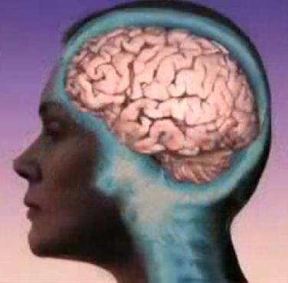
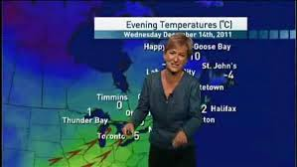
Huge obstacles to ACTION
Well-funded, highly successful “denial industry” has managed to instill doubt: Is CC actually human-induced and/or something to be concerned about. It’s therefore fine to be “apathetic.”
Action on climate change is framed as “anti-economic growth” and a government money grab thru new taxes.
We are both disconnected from nature. Fewer of us go outside, so all seems fine.
Our brain reacts poorly to slow motion phenomena
Humans deal poorly with future events; we deal poorly with uncertainty; and we are cost averse. Climate change is characterized by all three of these.
Shifting baseline syndrome – Because change happens so gradually, we hardly notice it. Soon, the change is radical (e.g., no birds singing) but seems “normal”
We are not reminded of climate change enough – not even on weather reports or Weather Network website!
Gratification for action now is in the distant future
Individual action seems meaningless. It all seems so hopeless.
A solution means a massive move away from fossil fuels and major changes to our lifestyles.

Slide 17
What you can do
Make climate change a regular topic of conversation with friends and relatives
Challenge deniers or those who don’t consider it an important threat
Demand much more aggressive action by politicians
Take part in Citizen Science monitoring programs (e.g., Ontario Reptile & Amphibian Atlas, PlantWatch, Great Backyard Bird Count) to become more aware of how the climate and nature are changing.

